Slide 1
DATS 6203 Final Project Group 6

Slide 2
Introduction
The goal of this project is to train a convolutional neural network to classify handwritten digits based on the SVHN dataset. This report will describe the dataset, network architecture, how the network will be trained, and then how the trained model performs on new data.

Slide 3
Description of dataset
The Street View House Numbers (SVHN) Dataset consists of images of house numbers in Google Street View images. Each image is classified as 1 of 10 digits from 0 to 9. There are 73257 digits for training and 26032 digits for testing. Although the original images with bounding boxes around individual characters is available, the images that will be used for this project are cropped images of single characters resized to a resolution of 32-by-32 pixels. The dimension of each images is 32X32X3. 3 represents values of red, green, and blue color channels in a color image.

Slide 4
Description of network
The deep learning network that will be used will be composed of 1 or more 2-dimensional convolutional layers each followed by a max pooling layer and then the rectified linear unit activation function. Then there will be a fully connected layer consisting of hundreds of neurons, followed by a softmax layer of 10 neurons. A dropout layer prior to the fully connected layer will also be implemented.

Slide 5
Description of deep learning network and training algorithm
The training algorithm will be either stochastic gradient descent or the Adam algorithm with mini-batches. The framework that will be used to implement CNN networks and training algorithms is the Pytorch module in Python utilizing GPU.

Slide 6
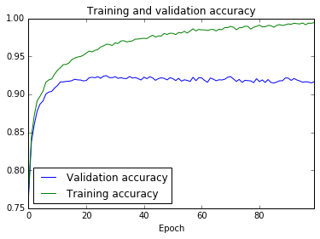
Experimental results
Digit | Precision | Accuracy | F1-score | Support
0 | 0.93 | 0.89 | 0.91 | 1744
1 | 0.94 | 0.95 | 0.94 | 5099
2 | 0.93 | 0.95 | 0.94 | 4149
3 | 0.87 | 0.90 | 0.88 | 2882
4 | 0.95 | 0.91 | 0.93 | 2523
5 | 0.93 | 0.90 | 0.91 | 2384
6 | 0.89 | 0.90 | 0.89 | 1977
7 | 0.93 | 0.90 | 0.92 | 2019
8 | 0.87 | 0.89 | 0.88 | 1660
9 | 0.89 | 0.90 | 0.89 | 1595
Avg/Total | 0.92 | 0.92 | 0.92 | 26032

Slide 7
Summary
We determined that the optimal way to train a CNN on the SVHN data with Pytorch and GPU is with Adam and a learning rate of 0.001 and a mini-batch size of 1000. In addition, normalization is important. The plots indicate that there is overfitting in all of the CNNs that were trained. However, reducing the number of parameters resulted in a slight decrease in prediction accuracy with an insignificant gain in computational speed. The best CNN model has 3 convolution layers and 656,830 parameters and is able to classify 91.6% of the test images correctly.
Additional parameters that might result in improved performance include padding in the convolution layer.

